Slide 1
Learning from a Learning User
Hongning Wang
^{CS@UVA}

Slide 2
Recommender systems
An indispensable component in modern information systems

Slide 3
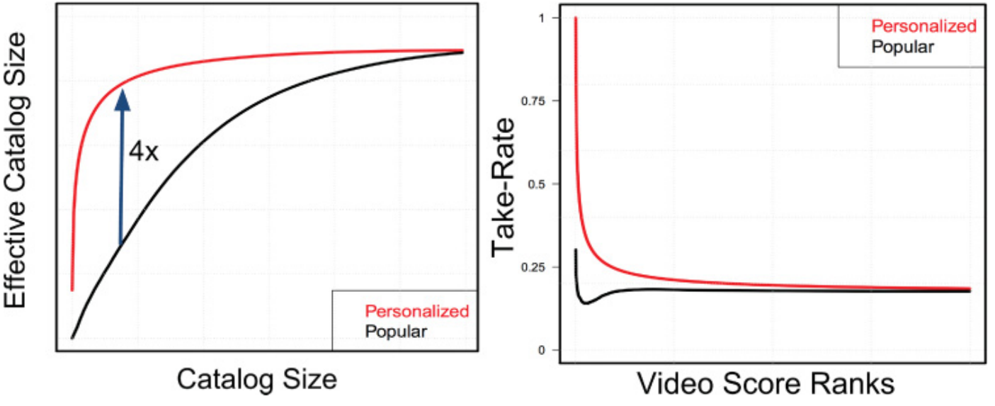
Recommender systems
An indispensable component in modern information service systems
In Netflix
“the combined effect of personalization and recommendations save us more than $1B per year.“ - Netflix’s Chief Product Officer, 2016

Slide 4
Interactive recommendation
A two-party game between the system and a user

Slide 5
Interactive recommendation
Strategy?
A two-party game between the system and a user
Goal:
Challenge:
Unknown preference;
Feedback is acquired on the fly, and it is not free!

Slide 6
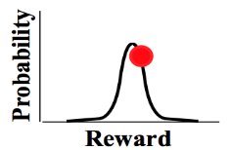
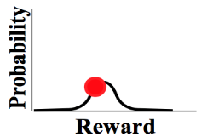
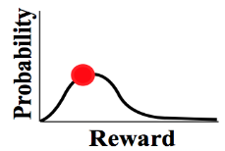
Interactive recommendation as bandit learning
Stochastic multi-arm bandit
Assumptions when used in recommender systems?
Under users’ possession?!
…
Goal: maximize the accumulated reward over T rounds
Reward distribution
…
Actions
A celebrated problem setting, and many popularly employed solutions:
Optimism in the face of uncertainty ^{[APS11]}
Thompson sampling ^{[AG12]}
Phased elimination ^{[ESY06]}
recommendation
collect
Agent/learner/policy
Reward
History

Slide 7
Two key issues
User is also learning the item utilities
User is not omniscient about the problem space
Exploration is necessary for no-regret learning
Their feedback becomes more relevant when more experience is collected
E.g., consume the recommended item

Slide 8
Two key issues
User is also learning the item utilities
User is not omniscient about the problem space
Exploration is necessary for no-regret learning
Their feedback becomes more relevant when more experience is collected
E.g., consume the recommended item
The system only observes the user’s binary response
No direct observations of rewards
Make the problem setting more general

Slide 9
A refined problem setup
Learning from a learning user
System’s goal: identify the best arm for the user
…
Goal: maximize the accumulated reward over T rounds
Reward distribution
…
Actions
collect
recommendation
decision
Agent/learner/policy
Reward
User’s goal: no regret about her past decisions
History
History
Only observes the revealed preference

Slide 10
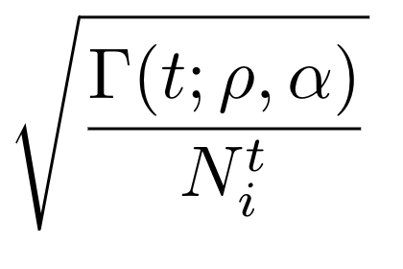
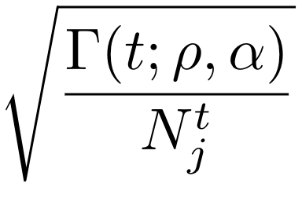
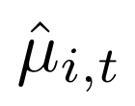
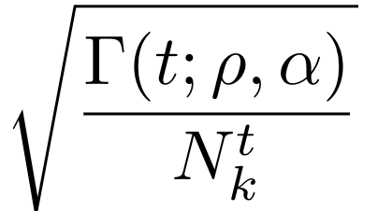
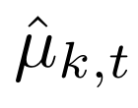
A learning user
How would such a user make decisions?
By the confidence interval of her estimated item utilities ^{[Aue02]}
With a high probability, the true value locates in this interval.
Upper Confidence Bound
Total number of consumed recommendations
User’s tendency to explore
User’s trust on the system
User-side hyper-parameters
Lower Confidence Bound
Item i
Item j
Item k

Slide 11
Evidence about user learning
Marketing science
“Consumer Learning, Brand Loyalty, and Competition” ^{[Vil04]} - consumers can gain further information regarding how well a product fits their preferences only by experiencing it after purchase. This could then generate loyalty for the products tried first.
Psychology
“Dimensions of Consumer Expertise” ^{[DJP06]} - as the exposure to a product or category grows over time, consumers become experts about their own tastes by learning their preferences through self-feedback.
Cognitive science
“Forgetful Bayes and myopic planning: Human learning and decision-making in a bandit setting” ^{[ZJ13]} - humans maintain confidence levels regarding different choices under uncertainty and make decisions based on them

Slide 12
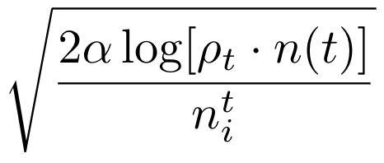
What can an accept contribute?
Update the confidence interval of the accepted item
Introduces non-stationarity in the feedback!
This also leads to a slightly increased confidence interval in all other items
Item i
Item i

Slide 13
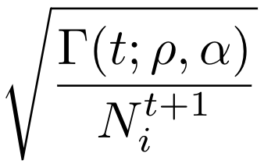
What can a reject contribute?
To the user
Nothing changes
Item i
Item i

Slide 14
What can a reject contribute?
To the system
Not sure which one is better
There must be at least one item that is better than the recommended item in the user’s estimated confidence intervals!
Item i
Item j
Item k
Eliminate this one to reduce search space

Slide 15
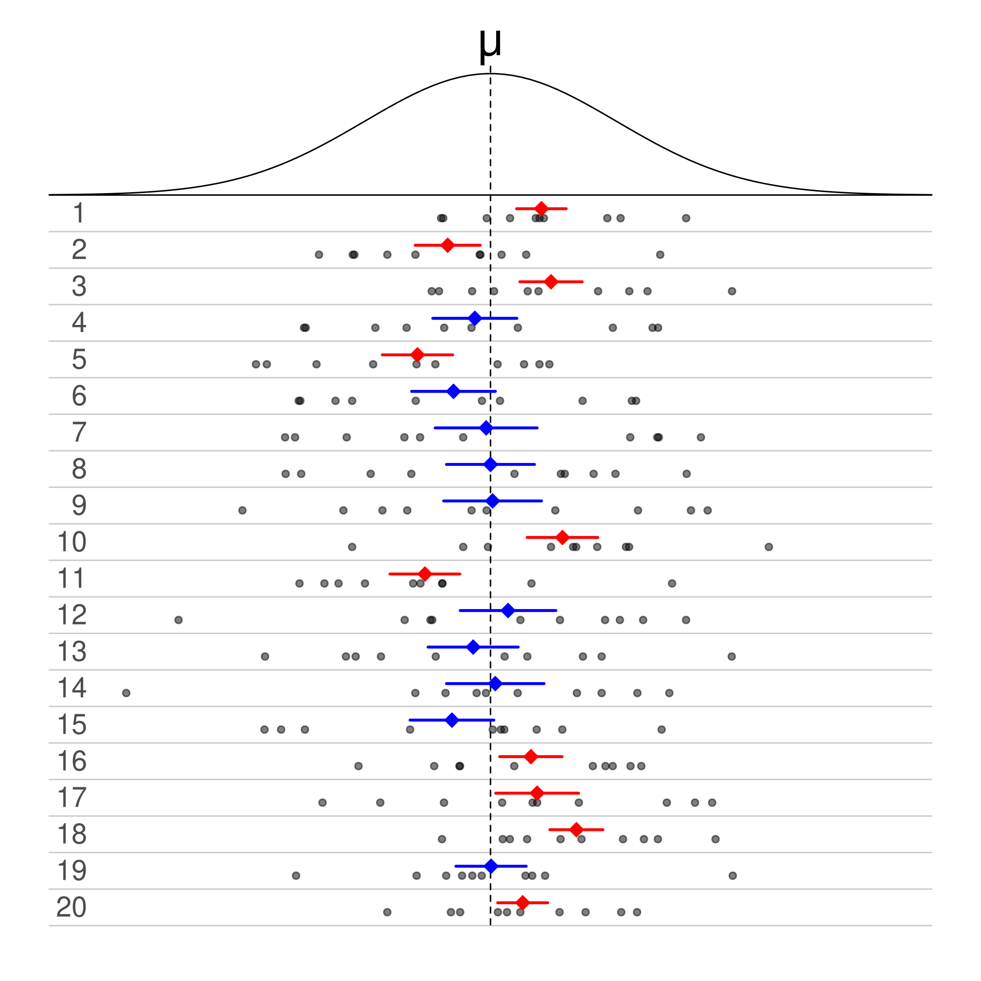
When can we confidently eliminate?
Increase by increasing the number of acceptances
Possible situations a system might encounter about the user’s reward estimation
Confidence interval does not contain true mean
Confidence interval contains true mean
Reminder about the CI:
We should only eliminate when this happens!
Image credit: https://en.wikipedia.org/wiki/Confidence_interval

Slide 16
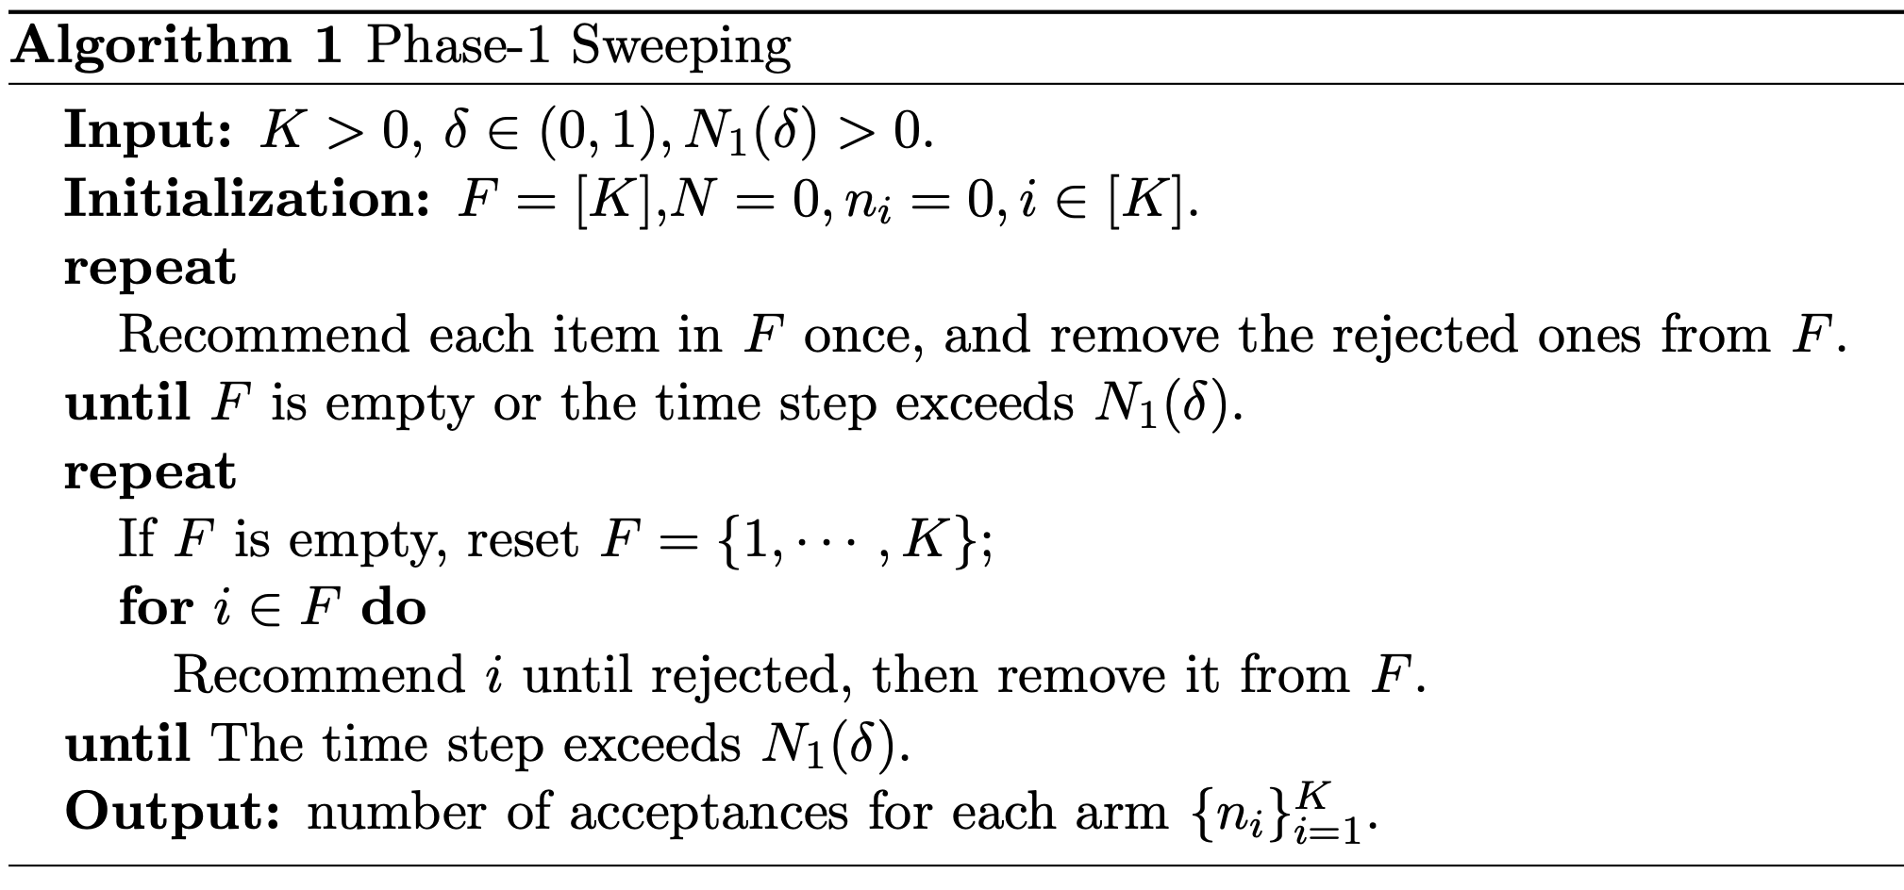
A two-phase elimination solution: BAIR ^{[AAAI’22]}
Phase-1: sweep through the item space
Prepare the user for accurate feedback
Breadth-first sweep for initialization
Goal: to collect enough number of total acceptances
Depth-first sweep

Slide 17
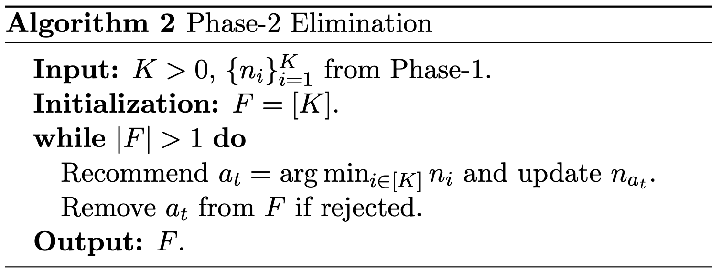
A two-phase elimination solution: BAIR ^{[AAAI’22]}
Phase-2: eliminate the sub-optimal items
Exploit user feedback
Start from the least explored one
Once reject, it is confirmed to be worse than something else
Now the confidence interval is accurate enough:

Slide 18
Regret analysis
Phase-1: sweep through the item space
To collect a sufficient number of acceptances, while ensure a small number of rejections
Sufficiency
Number of rejections (mostly from this phase)

Slide 19
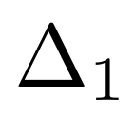
Regret analysis
Phase-2: eliminate the sub-optimal items
It terminates in finite steps, i.e., we can find the best item in finite steps
Gap between items’ true rewards:

Slide 20
Regret analysis
Phase-2: eliminate the sub-optimal items
It terminates in finite steps, i.e., we can find the best item in finite steps
A detailed break-down

Slide 21
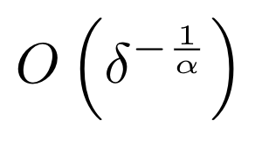
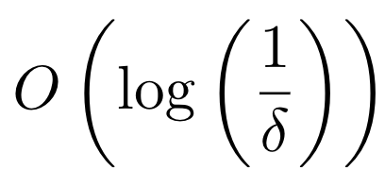
Lower bound analysis
Intrinsic difficulty when learning from a learning user’s revealed preferences
>
Our results:
Known result for best arm identification ^{[CL16]}:

Slide 22
Empirical evaluations
Simulation-based studies
Sampling
User hyper-parameters
Baselines
UNI: uniformly recommend every item and then output the one with the most acceptances in the end
Track-and-stop (T&S) ^{[GK16]}: best known algorithm for best arm identification with fixed confidence interval
EXP3 ^{[Aue95]}: a well-known adversarial bandit algorithm, and we choose the item with the most acceptances as its final output

Slide 23
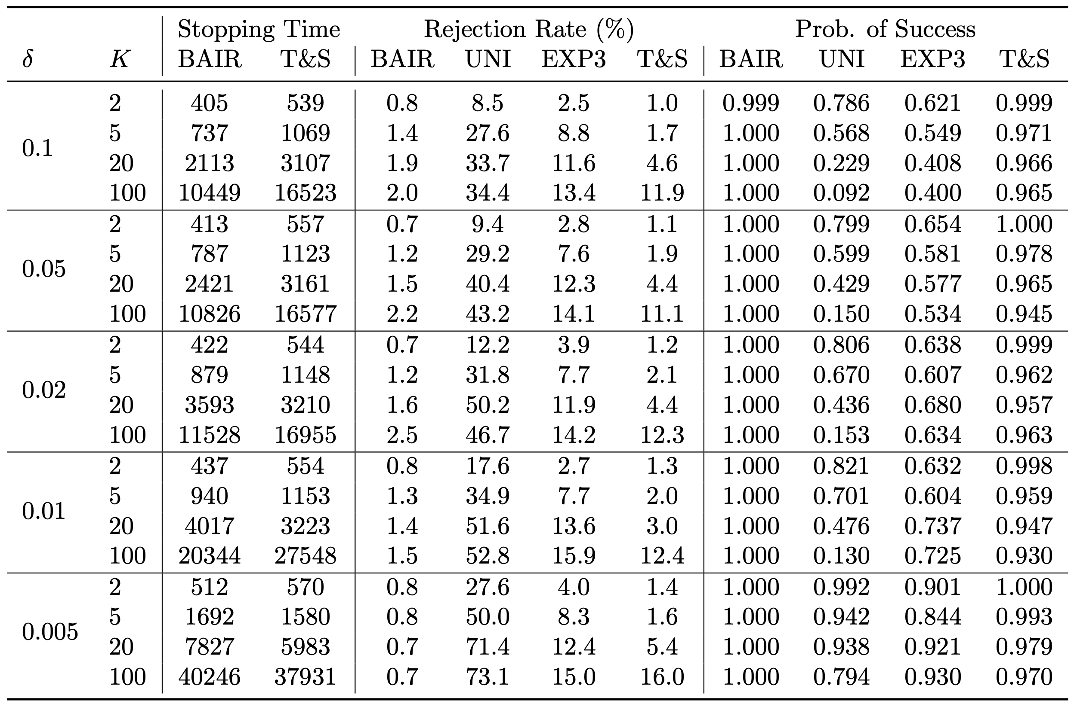
Experiment results

Slide 24
Experiment results
Having a shorter Phase-1 preparation
Possibly the choice
Provably sufficient
Clearly insufficient
An important direction of future work!

Slide 25
Summary
Learning from an explorative user’s revealed preferences
No longer assume a user is omniscient about the problem space, and naturally models users’ learning behaviors
Proves efficient system-side learning is still possible and the intrinsic difficulty of learning in such a problem setting

Slide 26
Facing a more sophisticated user?
in a contextual setting
Learning from a learning user
…
Reward distribution
System’s goal: identify the best arm for the user
…
User draws a more descriptive picture about the item space based on the item features
Actions
recommendation
decision
Agent/learner/policy
User’s goal: no regret about her past decisions
History
History
Only observes the revealed preference

Slide 27
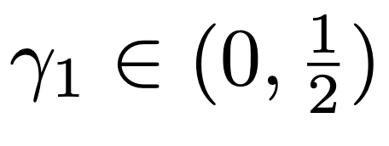
Modeling a learning user
User’s estimation rule
Linear reward assumption ^{[APS11]}:
Unknown to both user and system!
This is history dependent
Any learning algorithm $F$ that satisfies
Linear regression is a good example!
User’s prior
User’s experience
Inaccuracy of learning algorithm

Slide 28
Modeling a learning user
Non-stationarity in the feedback is still here and becomes even worse!
User’s decision rule
A simplified setting: choosing between two recommended items
Explore for improved estimation
Choose the one with a larger score
LinUCB is a good example!
Account for a wide range of user behaviors when facing uncertainty, including even irrational behaviors

Slide 29
What can we learn from such a user? ^{[ICML’22]}
Revealed preference between the recommended items
A cutting hyperplane suggesting where the true model parameter is!
$$≤$$
Our learning target!
Item 1
Item 2
Cutting direction
User’s decision error
Ellipsoid method!

Slide 30
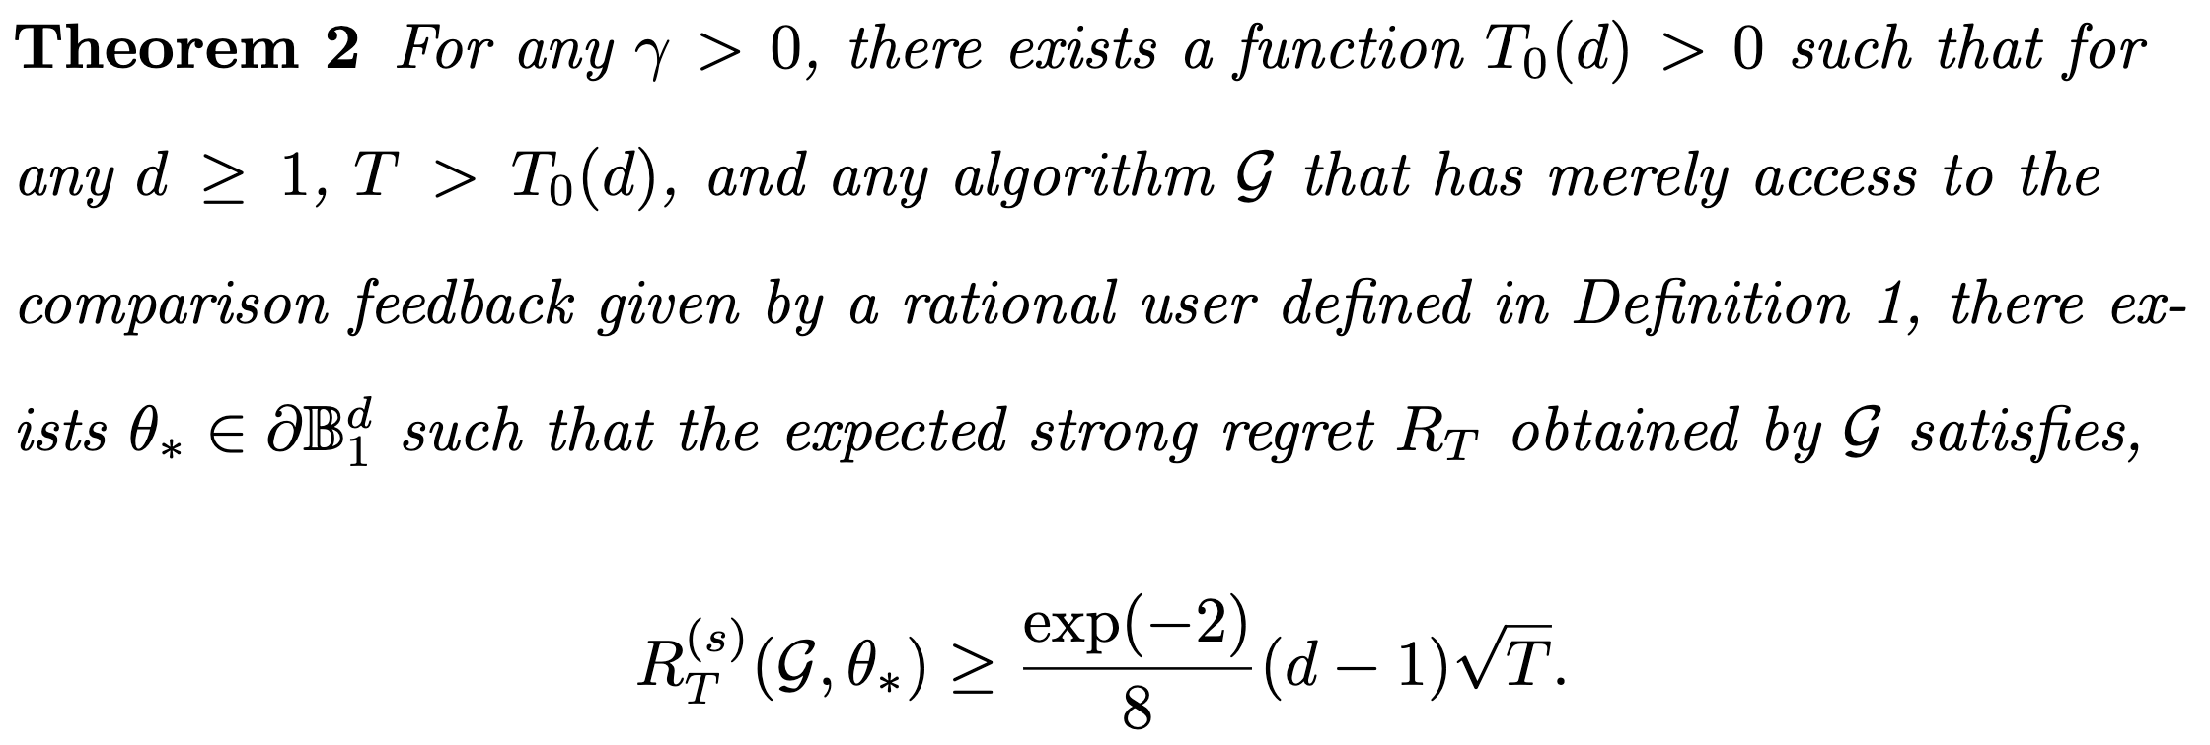
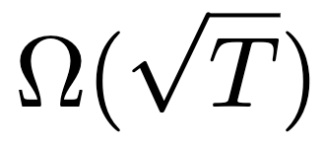
Regret lower bound
Intuitively, system’s learning cannot be easier than user’s learning, whose regret lower bound is already .

Slide 31
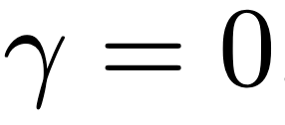
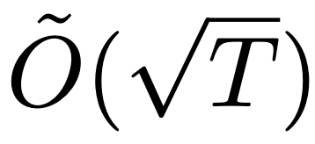
Regret analysis
Mostly affected by how quickly we can cut through the model space
By setting and
the regret of RAES is upper bounded by,
with probability .
Difficulty of the problem!
When the user is running LinUCB, and the regret of RAES is

Slide 32
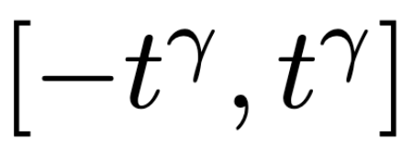
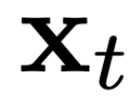
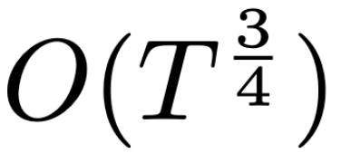
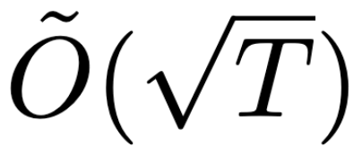
Experiments
Simulation based on the linear reward assumption
is drawn from and kept unknown to both the system and the user
Action set
A $(1,γ)$-rational user, with independently drawn from
Baselines
Dueling bandit gradient descent (DBGD) ^{[YJ09]}: maintains the current best action and compare with a neighboring point . Known regret:
Doubler ^{[AKJ18]}: using MAB to solve dueling bandit problem. Known regret:
Sparring ^{[SZB17]}: using two MAB instances to solve dueling bandit problem. No known regret analysis, but reported empirically better than Doubler.

Slide 33
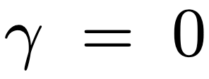
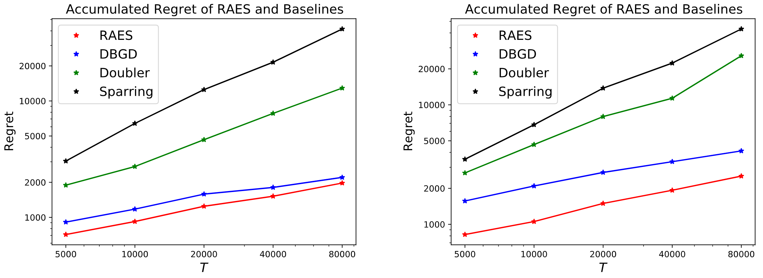
Experiment results
, user is running LinUCB

Slide 34
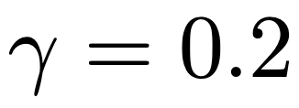
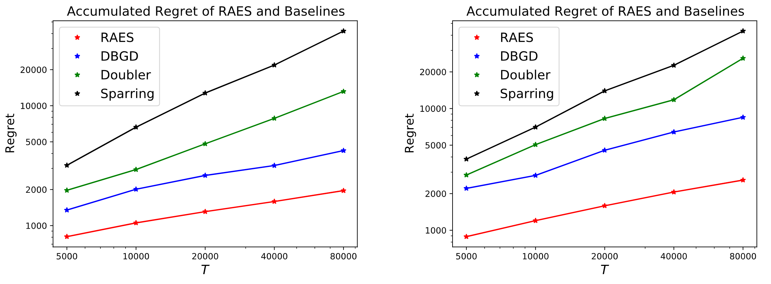
Experiment results
, stronger non-stationarity is introduced

Slide 35
Summary
Learning from a learning user in a contextual setting is still possible
An efficient ellipsoid method to search for the ground-truth model parameters based on users’ revealed preferences
Nearly optimal regret guarantee is provided
The negative empirical results suggest serious consequences of ignoring user-side learning
Learning from strategic learning users?
They can be cooperating or competing with each other
They might share different objectives

Slide 36
Acknowledgements
IIS-1553568
IIS-2007492
IIS-1838615

Slide 37
Publications
Fan Yao, Chuanhao Li, Denis Nekipelov, Hongning Wang and Haifeng Xu. ﻿Learning the Optimal Recommendation from Explorative Users. The 36th AAAI Conference on Artificial Intelligence (AAAI'2022).
Fan Yao, Chuanhao Li, Denis Nekipelov, Hongning Wang and Haifeng Xu. ﻿Learning from a Learning User for Optimal Recommendations. The 39th International Conference on Machine Learning (ICML'2022).

Slide 38
Selected references
[LR85] Lai, T. L., & Robbins, H. (1985). Asymptotically efficient adaptive allocation rules. Advances in applied mathematics, 6(1), 4-22.
[Aue95] Auer, P., Cesa-Bianchi, N., Freund, Y., & Schapire, R. E. (1995, October). Gambling in a rigged casino: The adversarial multi-armed bandit problem. In Proceedings of IEEE 36th Annual Foundations of Computer Science (pp. 322-331). IEEE.
[Aue02] Auer, P. (2002). Using confidence bounds for exploitation-exploration trade-offs. Journal of Machine Learning Research, 3(Nov), 397-422.
[CL16] Carpentier, A., & Locatelli, A. (2016, June). Tight (lower) bounds for the fixed budget best arm identification bandit problem. In Conference on Learning Theory (pp. 590-604). PMLR.
[GK16] Garivier, A., & Kaufmann, E. (2016, June). Optimal best arm identification with fixed confidence. In Conference on Learning Theory (pp. 998-1027). PMLR.
[APS11] Abbasi-Yadkori, Y., Pál, D., & Szepesvári, C. (2011). Improved algorithms for linear stochastic bandits. Advances in neural information processing systems, 24.
[AG12] Agrawal, S., & Goyal, N. (2012, June). Analysis of thompson sampling for the multi-armed bandit problem. In Conference on learning theory (pp. 39-1). JMLR Workshop and Conference Proceedings.
[ESY06] Even-Dar, E., Mannor, S., Mansour, Y., & Mahadevan, S. (2006). Action Elimination and Stopping Conditions for the Multi-Armed Bandit and Reinforcement Learning Problems. Journal of machine learning research, 7(6).
[GLS81] Grötschel, M., Lovász, L., & Schrijver, A. (1981). The ellipsoid method and its consequences in combinatorial optimization. Combinatorica, 1(2), 169-197.
[YJ09] Yue, Y., & Joachims, T. (2009, June). Interactively optimizing information retrieval systems as a dueling bandits problem. In Proceedings of the 26th Annual International Conference on Machine Learning (pp. 1201-1208).
[AKJ18] Ailon, N., Karnin, Z., & Joachims, T. (2014, June). Reducing dueling bandits to cardinal bandits. In International Conference on Machine Learning (pp. 856-864). PMLR.
[SZB17] Sui, Y., Zhuang, V., Burdick, J. W., & Yue, Y. (2017). Multi-dueling bandits with dependent arms. arXiv preprint arXiv:1705.00253.

Slide 39
Selected references
[Vil04] Villas-Boas, J. M. (2004). Consumer learning, brand loyalty, and competition. Marketing Science, 23(1), 134-145.
[DJP06] Daw, N. D., O'doherty, J. P., Dayan, P., Seymour, B., & Dolan, R. J. (2006). Cortical substrates for exploratory decisions in humans. Nature, 441(7095), 876-879.
[ZJ13] Zhang, S., & Yu, A. J. (2013). Forgetful Bayes and myopic planning: Human learning and decision-making in a bandit setting. Advances in neural information processing systems, 26.

Slide 40
Q&A
Thank you!
BanditLib: https://github.com/HCDM/BanditLib

